Slide 1
Electric Breakdown
Martin Seeger, 27.10.2013
in HV Switchgear

Slide 2
Introduction
Electrical breakdown can occur in…
Switching devices
  Circuit breakers (load and short circuit currents)
  Disconnectors (small capacitive currents (<1 A))
  Load break switches (MV, load currents and closing on short circuits)
  Earthing switches (small inductive currents)
HV conductors
  Busbar
  Bushings
  Voltage, Current transformers etc

Slide 3
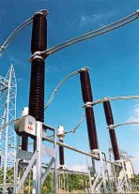
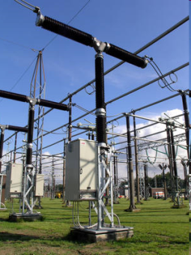
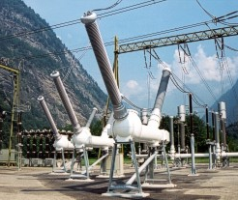
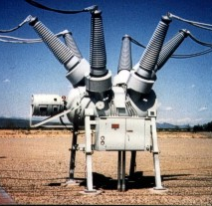
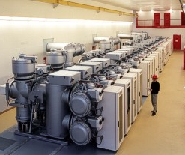
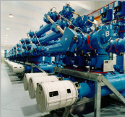
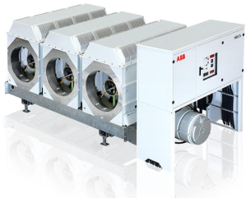
Introduction
Circuit breakers
Live Tank Breakers (LTB)
Dead Tank Breakers (DTB)
Gas Insulated Switchgears (GIS)
Generator Breakers

Slide 4
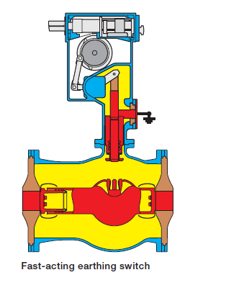
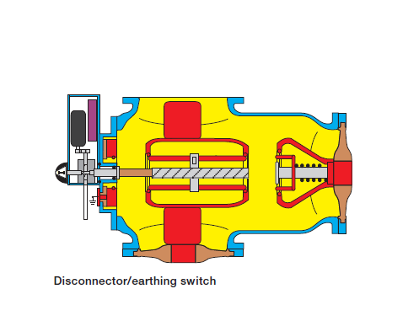
Introduction
Disconnector, earthing switches in GIS

Slide 5
Introduction
Breakdown
Breakdown happens/can happen:
  At closing of a switching device (always)
  At opening due to unsuccessfull interruption (e.g. below min arcing time)
  In the insulation system in case of excessive overvoltages or contaminations
  Electrical breakdown cannot always be avoided. Precise predictions are needed for optimised HV insulation/switch design
  Gaseous insulation media: Air (1bar), SF6 (4…8 bar)

Slide 6

Breakdown criterion
Air
  Air (HV outdoor, indoor (MV)) → based on streamer criterion
  Often sufficiently precise for pure gas bd
  Less precise prediction when solids are involved (charging, leaders etc)

Slide 7
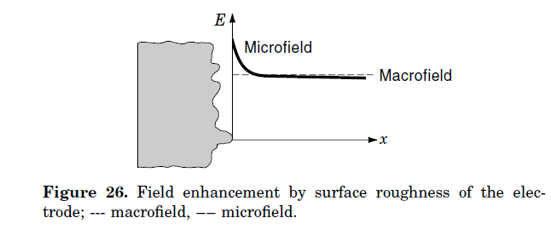
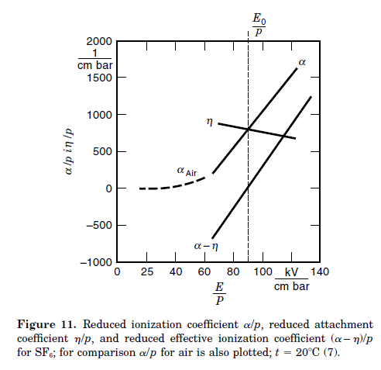
Breakdown criterion
SF6
  SF6 (encapsulated switchgear)
  → Breakdown by leader
  Often streamer inception sufficient criterion (surface)
  The minimum breakdown voltage in sound insulation system can be predicted by streamer inception (in principle)
  Due to the steep rise of the effective ionisation coefficient in SF6
  → sensitivity to surface roughness, streamer length of the order of 100um.
Boeck, «conduction and breakdown in gases», Wiley encyclopedy

Slide 8
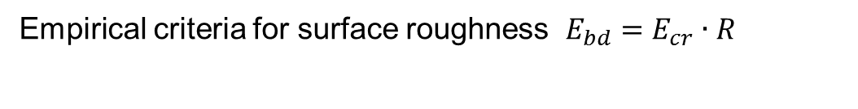
Breakdown criterion
SF6, surface roughness, ambient temperatures
Empirical criteria for surface roughness $E_{bd}=E_{cr}∙R$
Note: this does not take into account the availability of a start electron → for different voltage waveforms and polarity the bd fields are different

Slide 9
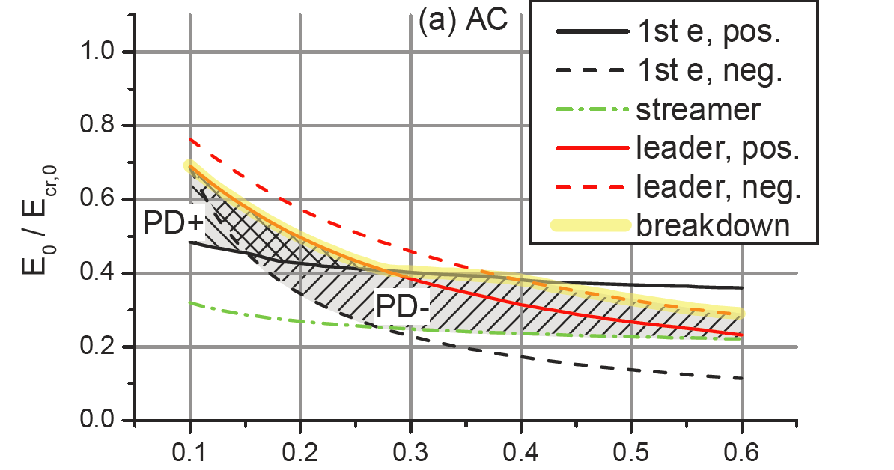
Breakdown criterion
SF6, protrusions, particles, ambient temperatures
M. Bujotzek, M. Seeger, «Parameter Dependence of Gaseous Insulation in SF6” IEEE Trans Diel El Ins, 2013
For particles/protrusions predictions need to take into account:
First electron
Streamer inception
Leader inception and propagation
→ Explains the field regions were partial discharges (PD) and breakdown occurs

Slide 10
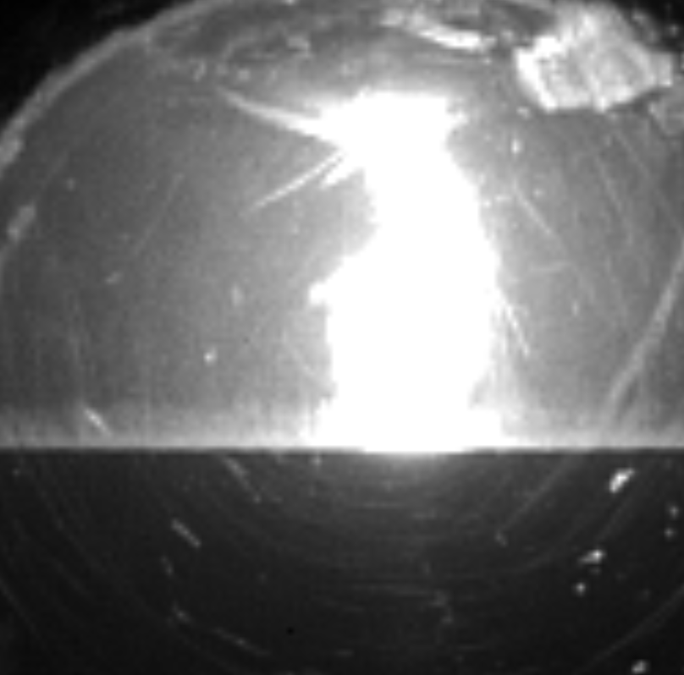
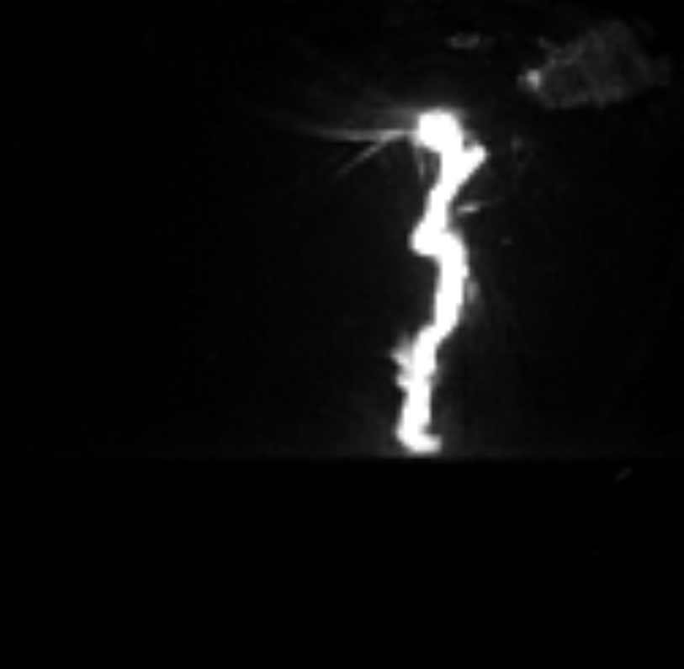
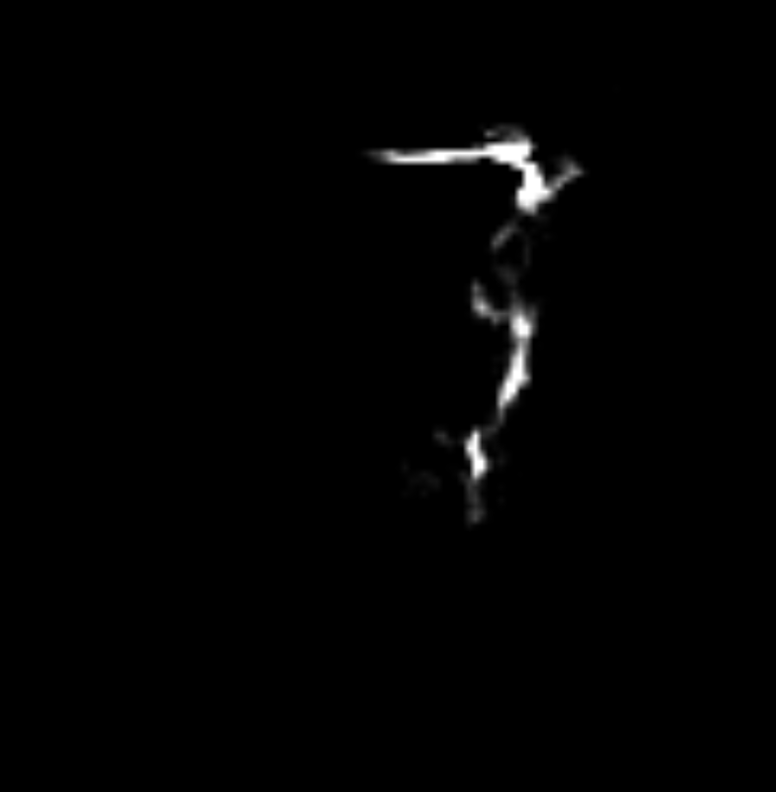
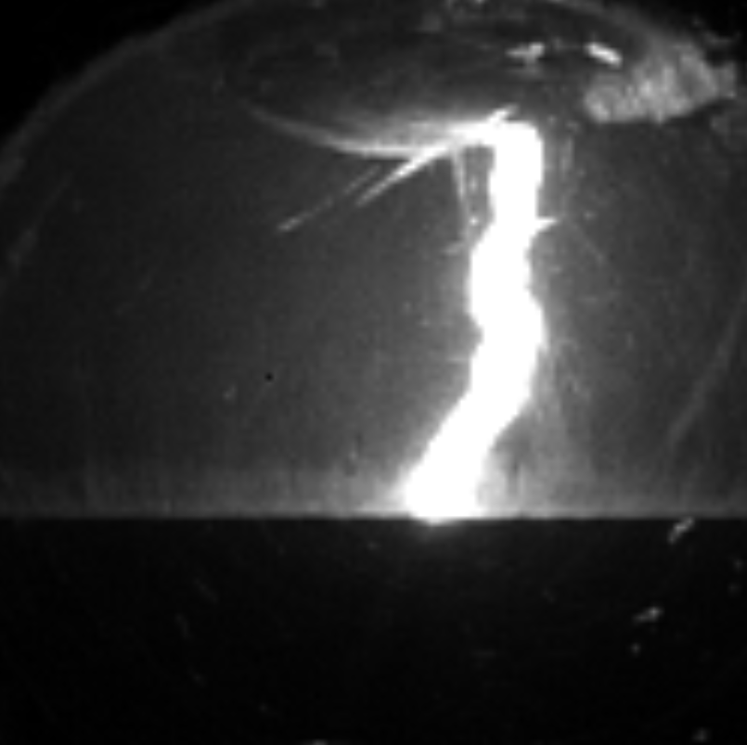
Breakdown criterion
SF6, hot gas breakdown (switching)
Low gas density (equivalent to 0.5…2 bar at T=300 K, typically)
High temperatures → different gas kinetics
Variation in composition (e.g. SF6, Cu, PTFE)
Non-equilibrium effects
Varying pressures and temperatures
→ Gas breakdown at elevated temperatures under realistic conditions difficult to study
CZ-42 μs CZ-18μs CZ-6μs CZ+72 μs

Slide 11
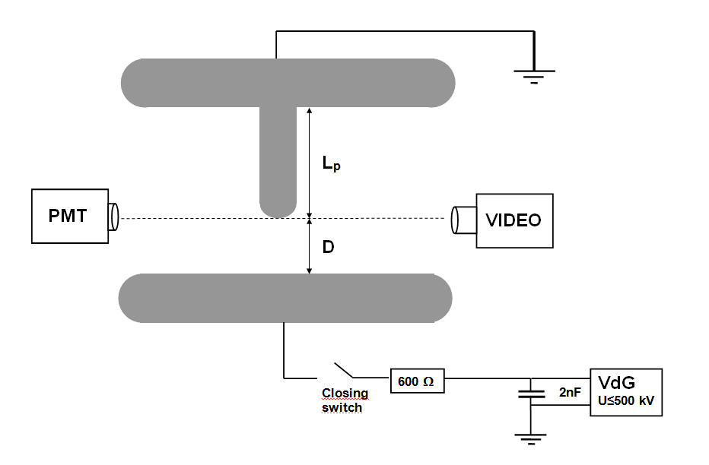
Breakdown and PD at pressures 0.25 …1.5 bar
SF6, plug plate
Low pressure breakdown → Some recent results will be shown (submitted to JOPD)
Low field enhancement of 3.5 (L=6 cm, D=3 cm, R=0.9 cm)

Slide 12
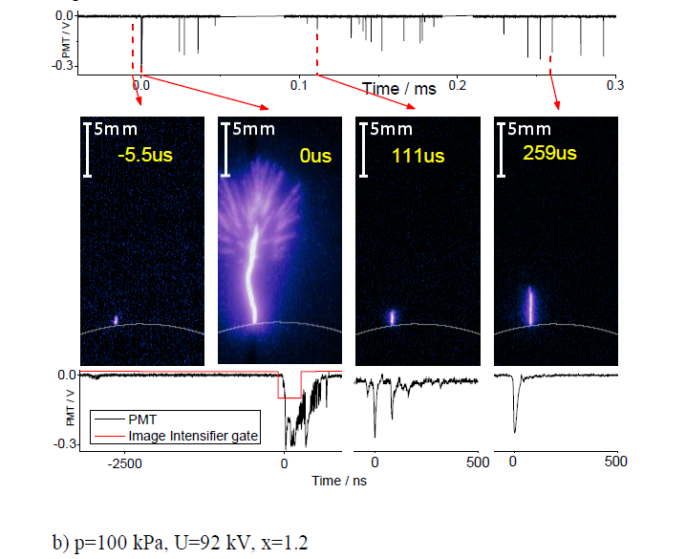
Breakdown and PD at pressures 0.25 …1.5 bar
SF6, plug-plate

Slide 13
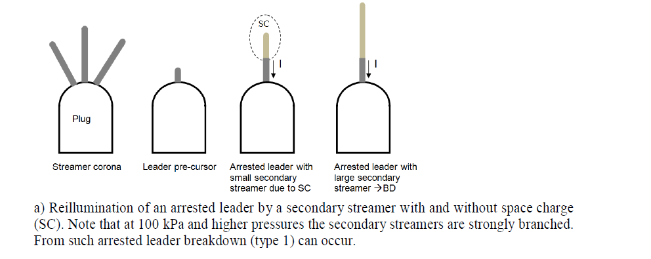
Breakdown and PD at pressures 0.25 …1.5 bar
SF6, breakdown
Breakdown mechanism
- Streamer corona
- Leader transition (pre-cursor)
- Leader propagation

Slide 14
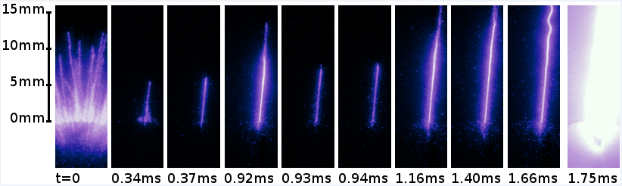
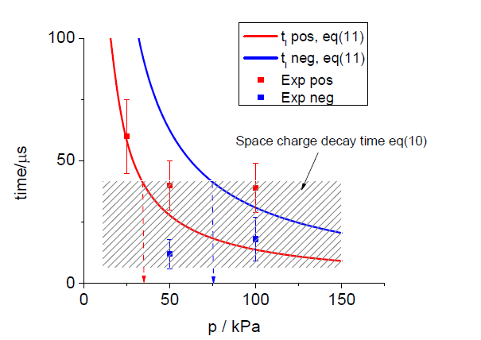
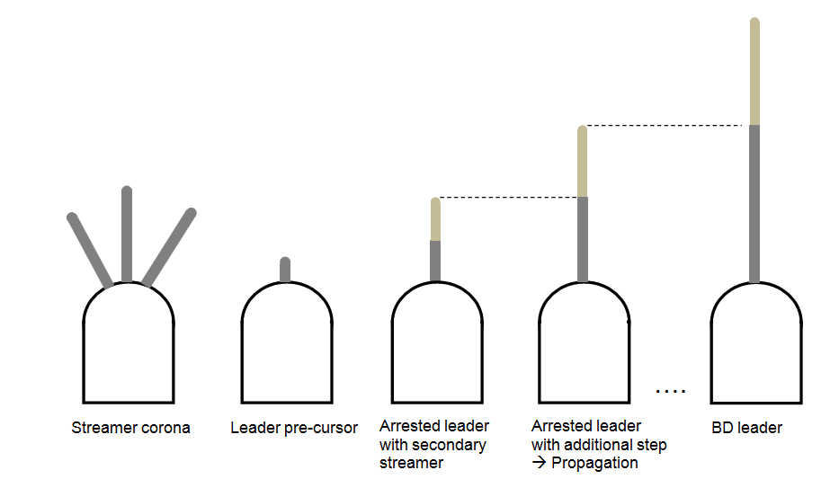
Breakdown and PD at pressures 0.25 …1.5 bar
SF6, «slow» breakdown at applied DC
At low pressures < 0.5 bar → «slow» bd (several ms)

Slide 15
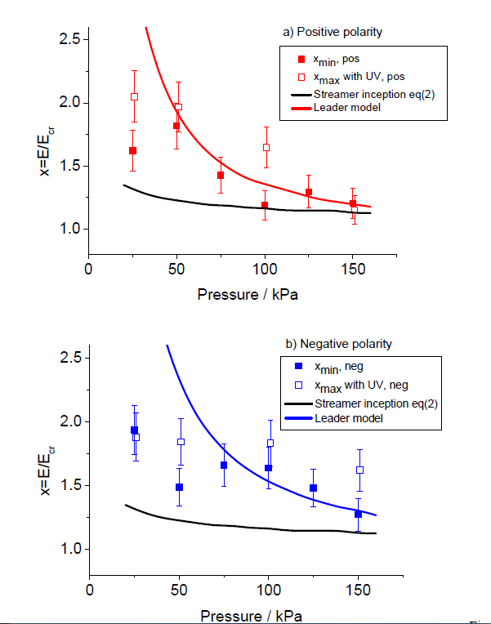
Breakdown and PD at pressures 0.25 …1.5 bar
SF6, breakdown fields
Breakdown occurs at fields higher than streamer inception
Breakdown fields can be predicted by Leader model
Breakdown in this pressure range influenced by PD behaviour
Similar to a breakdown from a much larger field enhancement at higher pressure (corona bump)

Slide 16
Breakdown and PD at pressures 0.25 …1.5 bar
SF6, streamer parameters
Streamer lengths are in the expected range (min-max)
At low pressures (<0.75 bar) streamer extension larger than at higher pressure

Slide 17
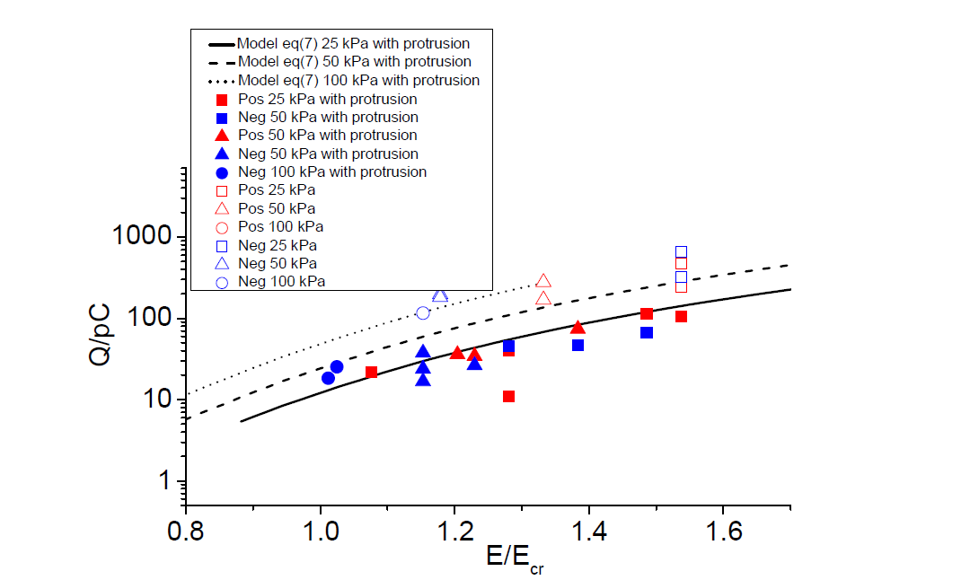
Breakdown and PD at pressures 0.25 …1.5 bar
SF6, charges
Charges are in the range of several 10…100 pC

Slide 18
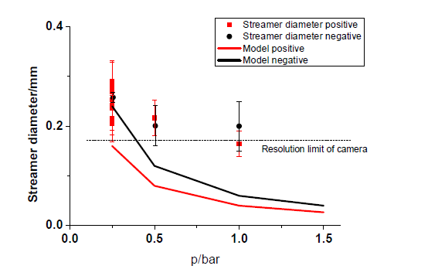
Breakdown and PD at pressures 0.25 …1.5 bar
SF6, Streamer diameter
Needs more precise optical investigations (ongoing)

Slide 19
Breakdown and PD at pressures 0.25 …1.5 bar
Conclusions
Breakdown at rough surfaces is decided by streamer inception criterion
Breakdown at low pressures has similarities to breakdown at high temperatures
Some fundamental processes can be studied at low pressures
Breakdown in this parameter range is determined by leader inception/propagation
This leads to breakdown fields larger than streamer inception fields
Streamer/Leader parameters are in the expected range and simple models can reproduce the measured breakdown fields

